Slide 1
FFT Overview for VA Prospective Providers Nov. 19th 2:00 to 4:00 Helen M. Midouhas M.S. Ed., L.P.C. Seattle USA www.fftllc.com

Slide 2
Agenda for Today
The Bigger Context: Emergence of evidence based programs
What is the evidence for FFT: FFT Research and Dissemination
What is FFT: Clinical Model Overview
Implementation for Model Fidelity and Sustainability
Referrals
Discussion/Questions

Slide 3
Context Changing world of FFT
FFT model phases vs. FFT intervention phases
Phase 1 (1979-1997)
-Evidence-base building phase
-Clinical Training Protocol
Phase 2 (1998-2006)
-Multi-site dissemination and accountability
-Independent research continues
Phase 3 (2007- )
-Further integration with diverse treatment systems
-Model specializations: CW, CM, GANG
-Research continues

Slide 4
Context Changing World of Practice
Changing “landscape” of practice in mental health, juvenile justice, social work
Why?
Push for Accountability…”where is the data?”
For program selection
For ongoing local evaluation
For everyday clinical practice
Increase quality and relevance of research
Solid trends,
consistent findings,
clear practice implications

Slide 5
Why we are here…youth/families we serve are...
Often seen as “difficult to treat”, “difficult to engage”…for good reason
Kazdin (2003), not uncommon to find dropout rates up to 60%
Poor clinical outcomes
“Toughest” kids
Multi system involved; multiple intervention failures
Outcome expectations are low
Willing to accept long treatment
Willing to accept low/moderate outcomes
Willing to see only short term outcomes
Continue to see Adolescents and families are not motivated
1990 consensus ….NOTHING WORKED

Slide 6
Context Adolescent Behavior Disorders
Probably no greater impact than in area of Adolescent Behavior disorders
Serious social impact on….
Families (psychological pain, siblings, family stability)
Communities (cost, climate, public safety)
Lives of the youth: Dr. Steinberg- “The brain’s malleability makes adolescence a period of tremendous opportunity- and great risk…if we expose our young people to positive, supportive environments, they will flourish” (From Race to Nowhere)
Treatment delivery systems………

Slide 7
Blueprint Initiative: (1996) Center for the Study & Prevention of Violence (U of Co.), Centers for Disease Control (CDC) and Office of Juvenile Justice Delinquency and Prevention (OJJDP)
To identify “effective programs” to help communities
Find programs that work (evidence of significant deterrence effects; reduce onset, prevalence or individual offending rates– with risk/protective factors that mediate decreases in delinquency, drug use, violence, etc.)
Work over time (they have sustained effects—effects don’t wear off once leave the program)
With high quality research (multiple evaluations, clinical trials, random assignment, low participant attrition, etc.)
Are‘replicable’ in local communities (multiple site replication; robust, “exportability,” with strong implementation procedures and on-going quality control).
Cost effective (w/ potential positive cost/benefits)
Flexible enough to fit the needs of any given community.

Slide 8
Effective Programs -- “EBPs”
Searched the literature of over 600 programs
Good News….
There are prevention and treatment programs that work, over time, have impact on recidivism/delinquency, drug use/abuse & other mental health problems--approaches with strong research support (universal, selected, or indicated)
11 now 14 Blueprint Programs…..highest standard
(21 now 46 Promising Programs)
Bad News….
Most surprising is that most programs don’t work

Slide 9
What doesn’t work (no overall positive effect) (Delbert Elliott, CSPV, 2000) Additional reference: Sherman et al., 1997
DARE (5th and 6th grade curriculum)
Gun buyback programs
Home detention with electronic monitoring
Boot Camps
Peer Counseling programs
Summer jobs (targeting at risk youth)
Wilderness/challenge programs
Casework/counseling
What produces negative (iatrogenic) outcomes
Waivers to adult (criminal courts)—longer processing and pre-trial detention, racial bias, lower probability of in-custody treatment, increased risk of re-offense upon release).
Scared Straight
Shock Probation / Parole

Slide 10
Blueprint Models www.blueprintsprograms.org
Blues Program (Cognitive Behavioral Group Depression Prevention)
Body Project (Dissonance Intervention)
Brief Alcohol Screening & Intervention for College Students (BASICS)
Functional Family Therapy (FFT)
Life Skills Training
Multisystemic Therapy- Problem Sexual Behavior (MST-PSB)
Multisystemic Therapy (MST)
New Beginnings (Intervention for Children of Divorce)
Nurse Family Partnership
Parent Management Training (Oregon Model)
Positive Action
Project Towards No Drug Abuse
Promoting Alternative Thinking Strategies (PATHS)
Treatment Foster Care Oregon

Slide 11
Functional Family Therapy
Research-based prevention (Indicated) and intervention (Selective) program for at-risk adolescents and their families
Targets youth between 10/11-18….
Prevention intervention--status/diversion kids/at risk for out placement or further penetration into care systems
Treatment intervention--moderate and serious delinquent youth
Short-term, family-based program
12-15 for moderate cases, 26-30 for more serious cases spread over 3 to 5 months
Range of adolescent problems
Violence, drug abuse/use, conduct disorder, family conflict

Slide 12
Functional Family Therapy Treatment program for…..
Clinical problems falling under the label “Externalizing Adolescent Behavior Disorders”
Conduct disorder
Oppositional defiant disorder
Drug use/abuse
Other behavior problems…violence, school problems, truancy, etc.
Other mental health problems of adolescents
Anxiety/depression with behavior disorder symptoms expressions
Parent-child/family conflict issues
Child Welfare Issues

Slide 13
The Evidence Base for FFT
Results of Three Decades of Research

Slide 14
Supervision
Implementation
Training
Sustainability
Clinical Practice
Culture
SES
Family Support Networks
Economic Conditions
FAMILY
FRIENDS
Family’s Jobs
Friend’s Family
NEIGHBORHOOD
SCHOOL
Immigration
Built Environment
Health & Social Services
Dissemination Studies
Basic Research
Laws
Research
Process Studies
Effectiveness Studies
Efficacy Studies
Notes:
14

Slide 15
The Evidence of Functional Family Therapy
Impacts:
Effectively treating adolescents with the entire range of Disruptive Behavior Disorders
(with completion rates 70% and higher, improvement in family functioning, supervision, mental health, D&A, Ultimate Outcomes of At Home, In School, and No New Violations at 85% or higher)
Interrupting the matriculation of these adolescents into more restrictive, higher cost services
(General: 25 to 60% recidivism rates, decrease in severity & frequency, MD: FY16 one year post-86% had not been adjudicated delinquent/convicted, and 93% had not been committed to DJS/ incarcerated for a new offense. Additionally, 86% had not been placed in residential placement with DJS. PA 2012-2014 81% SA reduction in youth referred for SA)

Slide 16
The Evidence of Functional Family Therapy
Preventing younger children in the family from penetrating the system of care
(Sibling study-20% court referral-Klein et al.)
Preventing adolescents from penetrating the adult criminal justice system
(9% rate of adult court referral vs. 41 % for treatment as usual)
Reducing costs: $3500 and $4950
(Redirections: 22K per youth in community savings vs. residential=19 mil savings in 09-10, WA state, PA-30K, KANSAS- cost of placement is 10X that of supervision and EBP)

Slide 17
FFT Fidelity matters (Turner et al, 2017)
Supervision and experience led to continued improvements in fidelity after initial training
Higher fidelity of treatment was associated with more favorable outcomes.

Slide 18
FFT Inc and Washington State / Juvenile Rehab Administration Therapist Model Adherence & Clinical Outcomes
38%* reduction in felony crime
50%* reduction in violent crime
$10.67 return for each $1 invested
$2100 per
family cost to implement
* Statistically significant outcome as compared to the control condition

Slide 19
FFT LLC Dissemination
Global Footprint:
350 sites+
5,000+ therapists trained and practicing worldwide
50,000 families served per year
Sites now 20 years out in implementation
Rural, remote and urban settings
Highly diverse communities
International Implementation
Netherlands, Norway, Sweden, England, Scotland, Canada, New Zealand, Denmark, Singapore, Australia
FFT LLC statewide coordinated multi site projects in Denmark, Norway, the US states of Maryland, Washington, California, Pennsylvania, Maine, South Dakota, Georgia
Care systems: child welfare, facility-care re-entry, school, mental health, drug-alcohol, juvenile justice, wraparound

Slide 20
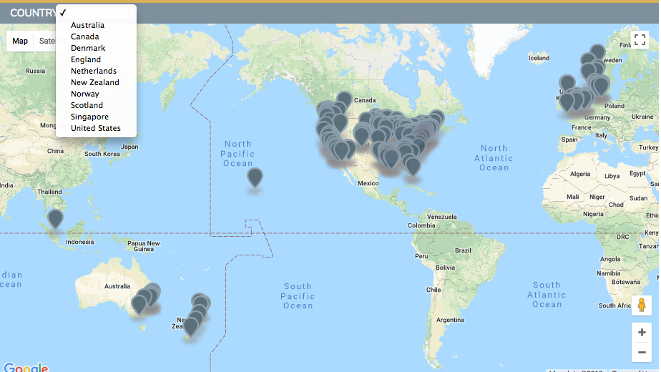
FFT sites: 255
FFT-CW sites: 62
FFP: 46

Slide 21
Functional Family Therapy
Clinical Model Overview

Slide 22
The Challenges Our Families Often Face:
Risk Factors:
Problem Behaviors, Maladaptive Attributions
& Emotional Reactions, Racism, Historical and Biological
Challenges, “Diagnosis,” Poverty &
limited community resources
These usually are the most apparent
deficits which can overwhelm the family’s
ability to cope

Slide 23
FFT’s Goal: To Unlock, Develop, and Make Available The Family and Community Strength & Protective Factors
Strengths, Protective Factors:
“Internal” and ecosystemic resources
often not in use by or available to
the family (or the environment)
at the time of referral

Slide 24
FFT families often have…
A long history of multi system involvement
A history of many change attempts, and often a history of failure at those attempts
With multiple ‘issues’ and often at elevated risk
Who drop out quickly from interventions
Are lacking in resources; often from communities lacking economic resources, maybe disproportionately from communities of color, recent immigrants
Often with other family members who have significant needs and risks of their own
Who at the end of the day will likely still be a family
Yet are often seen as not able to be engaged or motivated, but rather as needing to be managed
With parents who seem to have given up and who sometimes want someone else to parent their youth
Notes:
Audience often relates to this and they start nodding their heads… read this slide.
- disproproportionality because of biases.

Slide 25
Frequently Addressed Risk Factors w/Parents
Inconsistent parenting (not matched to what the youth needs) and even care-giver source
Violence/abuse (as a reaction and/or coercive?)
Parental mood / anxiety disorders
Parental substance abuse
“Parental” high conflict low resolution
Inflexibility in parent match w/developmental stage of changes
External system pressure on parents; economic, etc

Slide 26
Frequently Addressed Risk Factors with Adolescents
Mood Disorders (Depression, Anxiety)
Suicidal ideation or history
Pattern of self harm (cutting)
Substance Use
Involvement in Juvenile Justice System
Out-of-home placement history (mental health, juvenile justice)
Truancy and Running Away behavior
Parenting and/or pregnant teens

Slide 27
FFT’s Underlying philosophy
FFT draws from family systems theory and behavioral approaches.
It is based on the theory that problem behaviors serve a function within the family. Family members develop ways of interacting that help them to get their relational needs for closeness or distance met, but these patterns of interacting may also create or maintain behavior problems.
FFT achieves changes by improving family interactions and developing family member skills that are directly linked to risk factors and issues leading to the need for formal therapeutic intervention.

Slide 28
Given The Ecosystemic and Multiphasic Complexity, Why Start With FAMILY FIRST?
For starters, for most 11-18
year old youth, the family is
a common intersection point
For multiple systems
Self-Control
Academic
Self-Efficacy
.24
.19
.70
Family
Bonding
.59
Family
Super-
vision
Family
and Peer
Norms
.88
Substance
Use
.40
Social and
Community
Prevention
.14
(N=8,576)
(Center for Substance Abuse Prevention)
Notes:
28
Correlations between this for potential…center for substance abuse preventions
One predicts the other….with all increases probability

Slide 29
Super Summary of the FFT Model and “FFT Attitude:”
- A Philosophy / Belief System about people which includes a core attitude of Respectfulness; of individual difference, culture, ethnicity, family form
- A family focused intervention involving alliance and involvement with all family members (Balanced alliance) with therapists who do not “take sides” and who avoid being judgmental.
A change model that is focused on risk and (especially) protective factors – “Strength Based”
With interventions that are specific & individualized for the unique challenges, diverse qualities, and strengths (cultural, personal, experiential, family forms) of all families and family members.
And an overriding Relational (versus individual problem) focus
Notes:
29

Slide 30
A phase-based approach…
Each phase has its own assessment focus, intervention goals, and intervention strategies and techniques
Interventions start with creating a motivational context for change; and
Build to changing individual behaviors and patterns of family interaction
Therapist utilize different strategies over the course of treatment
Relational vs. Structuring/Directive
Interventions include an ecological focus, particularly in pre-treatment linking and in generalizing change

Slide 31
Phases in FFT
BEHAVIOR
CHANGE
P OO
ROO
EOO
TOO
ROO
EOO
AOO
TOO
MOO
EOO
NOO
TOO
E
N
G
A
G
E
M
E
N
T
P
O
S
T
T
R
E
A
T
M
E
N
T
MOTIVATION
RELATIONAL ASSESSMENT
GENERALIZATION
S E S S I O N
1 2 3 4 5 6 7 8 +
Copyright FFT LLC 2012
Notes:
Although we are a family-first model, therapists must be aware of and work to influence multiple systems. This multisystem focus is not limited to generalization. From the outset, therapists must plan and intervene to address multisystemic demands. Over time, the focus increases, but even during initial contacts, therapists must incorporate interventions to address the requirements/needs of other systems (such as juvenile justice or school).
The assessment of other systems changes over the course of treatment as cases progress from engagement to motivation to behavior change to generalization.

Slide 32
Who Are The “Major Players”?
1 – Family member(s) seen as part of the “problem” according to referral source(s).
2 – Family members we think (based on referral info and first calls to the family) are likely to “shut the process down” - and who probably can!
3 – Family members we think are necessary to begin change
4 – Important larger family system members (e.g., grandmother) or involved support systems (e.g., mother’s best friend & neighbor) who will participate and are “appropriate” participants vis-à-vis retaining a influential role with the youth / family.

Slide 33
The Spacing of Sessions During Engagement and Motivation
The spacing, or number of days between the first, 2nd, and 3rd FFT sessions depends primarily on:
1 – the severity of risk factors
2 - the immediate availability of protective factors
3 - your overall judgment of how long the family can go without a major disruption
With high risk families we might expect 3 sessions in the first 10 days after referral to FFT.

Slide 34
Therapist Model Fidelity Matters Step two: the context in which therapists operate and are supported also impact fidelity and sustainability…
Or in other words…How can we improve our chances to successfully implement FFT in the real world?

Slide 35
FFT Dissemination Standards
Working group of 3 to 8 clinicians trained in year one of implementation, with a team leader/supervisor trained in year two of implementation to provide consultation.. Supervisor is case carrying.
Meet weekly in consultation on FFT cases provided by trained supervisor/consultant (2 hrs per week).
Maintain minimum caseload of 5 cases at any given time (20 hrs. per week) and no more than 10 to 12 cases at any given time if full time.
Each therapist receives a minimum of initial clinical training, follow-ups and on-going case consultation (initial dosage of training)
Individual therapist and group receiving level of supervision, consult and training appropriate to degree of adherence and competency
Web based CSS to assist with staying on track and on going fidelity monitoring and quality improvement

Slide 36
FFT Project Development
Referrals

Slide 37
Referral Considerations
Inclusion Criteria
-10/11 to 18 years old
-In community or ready to go into the community
-Family Available
-Youth is Returning to family
-Inclusionary referral behaviors include externalizing behaviors, internalizing symptoms, and/or substance abuse.
-Referral issues can be from one domain (externalizing alone) or in combination (co- morbidity of substance abuse and externalizing behaviors).

Slide 38
Referral Considerations
Exclusion
Youth 10 years of age or below (as primary referral)
Youth who have no psycho-social system that constitutes family (shared history, sense of future, some level of co-habitation)
Youth is scheduled to be sent away from family (remand, placement, foster care, etc)
Sexual Offenders
Youth with current acute psychosis.
Youth that present with severe psychiatric illness:
□ actively suicidal
□ actively homicidal
□ actively psychotic

Slide 39
Referral Considerations
Capitalize on momentum…
Decrease length of time b/w identification of problem and intervention
Start FFT as close as possible to the event prompting the referral
Use expectations-- avoid youth having nothing happen after identification of a problem.
Effectively sequence interventions (what comes first??)
Lethality… (e.g. child abuse invest; d/a toxicity, etc.)
With FFT, E/M is strong way to start family down the road of intervention … with the generalization phase of FFT being effective for making referral to next appropriate service that will help maintain/extend change.
Simultaneous referrals?

Slide 40
Referral agent communication w/ family can set the stage for strong beginning to FFT.
Content when talking to family about FFT referral:
FFT is short-term; highly effective; reduce recidivism; impacts sibs…
Why family?
Issues arise through family; can begin to be solved there.
Families support youth long after outside agencies gone.
Any ‘system involvement’ impacts the whole family.
Often no one knows the youth better than the family.
W/ family involved, changes can happen quicker.
Family can support youth more effectively than youth on his/her own.
If affects family, may also impact younger sibs.

Slide 41
Functional Family Therapy
Project Referral Process?

Slide 42
Functional Family Therapy useful websites….
www.fftllc.com
http://episcenter.psu.edu/ebp/familytherapy

Slide 43
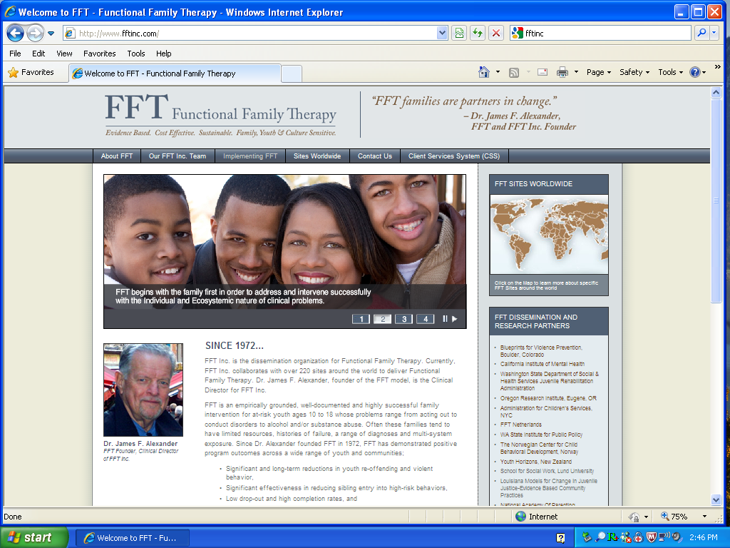
www.FFTinc.com

